Slide 1
Computer controlled machines
Asimava Roy Choudhury
Professor ME dept
IIT Kharagpur

Slide 2
Computer control of manufacturing systems - Yoram Koren
Numerical Control and computer aided manufacturing - Kundra Rao and Tewari
CAD/CAM principles and applications - P N Rao
Mathematical elements of computer graphics - Rogers and Adams
Digital computer electronics - Melvin Groover

Slide 3
Computer Numerical control – what is it ?
Control achieved by the use of
Numbers, symbols, signals, Letters, Codes, Words, instructions
In short, a Language-based communication with machines to be controlled
Inputs to the machine → through numbers, letters and codes
The processing of data → through numerical calculations and logic operations
The execution of operations → through generated signals

Slide 4
Numerical control, computer numerical control
In the beginning – only numbers and alphabets were used to achieve control, together with hard-wired circuitry – there was no computer - so it was just numerical control
Later, with the advent of computers, a computer was used in the process of control – so it became computer numerical control or simply computer control

Slide 5
Area of application of computer control
Is CNC primarily meant for mass (high volume) production ?
Fixed automation → SPM (Special purpose machines) with automated material handling devices are employed in such cases. This helps in reducing machining time, cyclic idle time and non-cyclic time losses.
Why not CNC ? – In mass production, there is hardly any change in part design over extended periods of time. Hence, CNC, which possesses flexibility –is not necessary in mass production.
Why not Fixed automation for low volume production ? In low volume production, part design changes frequently. Fixed automation is not amenable to frequent changes.
But if control is achieved by application of letters, numbers, codes and language, it is easy to change – and that is CNC
Hence – flexibility is the one advantage which makes computer control more suitable than fixed automation in case of low volume production.
In addition, CNC has the ability to manufacture complex shapes without the use of part-specific tooling.

Slide 6

How is computer control achieved ?
Motor
Speed gear box
1:1
Carriage
Feed Gear Box
Nut
By interfacing the machine with a computer
By modifying conventional machine tool architecture
By adding devices which permit the control of motion and other actions from computer
By writing and executing a program from the computer

Slide 7
What is a CNC program ?
A CNC program is a sequence of commands, written in a suitable language, meant for controlling the operations of a machine
When executed, it makes a machine tool carry out some motions and auxiliary operations
As a result, a part is successfully produced from a blank
There are other operations also, apart from machining, which are successfully controlled by CNC program execution.

Slide 8
Example of typical command blocks
N006 G90 G00 X20 Y30
N007 Y50
N008 G01 X100 Y100 F200
N009 G02 X140 R30
N010 M30
Y
(20,50)
(100,100)
(140,100)
r30
(20,30)
X

Slide 9
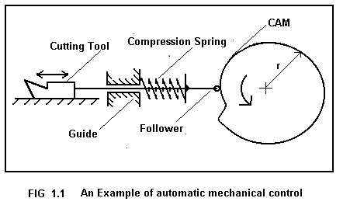
In mechanical automation
Motion is controlled by physical devices, like Cams, jigs, templates, tracers, limit switches, guides, operators etc
Question – In order to get constant forward feedrate of the cutting tool, what should be the profile of the CAM, which is undergoing uniform circular motion ?

Slide 10


Slide 11
Computer controlled machines
CNC is capable of controlling a machine through
Programmed instructions → Digital signals → rotation of motors → leading to
Achieving a programed extent of motion
Achieving a programmed ratio of axes velocities
Moving at programmed feed velocity along cutter path

Slide 12
Digital signals, Binary logic and logic gates
Digital circuitry is employed in almost all aspects of CNC control. Example : Data input, data storage, data processing, interpolation, motion execution, feedback etc.
AND
a
c
b
a
OR
c
b

Slide 13
Architecture of the control unit
MCU = DPU + CLU
MCU = Machine control unit
DPU = Data processing unit – contains data entry, data processing, interpolator
CLU = Control loops unit – contains all devices for achieving required motion along an axis (example : The motor, the lead screw-nut, the gear box, the position down counter, the feedback device etc)

Slide 14
What are the modifications of the conventional machine tool
More robust and rigid for the same power level (to limit tool deflections due to cutting forces. Tool deflections change the actual depth of cut)
Backlash elimination, incorporation of recirculating ball screw-nut mechanism
Gear box elimination – gear boxes limit the ratio of axes speeds
Feedback where necessary
Simple kinematic chains / structures instead of complex or compound chains / structures
Motors with lower time constant (faster response)
Interpolator where necessary
Control over displacement, velocity, acceleration of the axes in order to avoid overshoots, sluggish response and resulting inaccuracies in part geometry

Slide 15
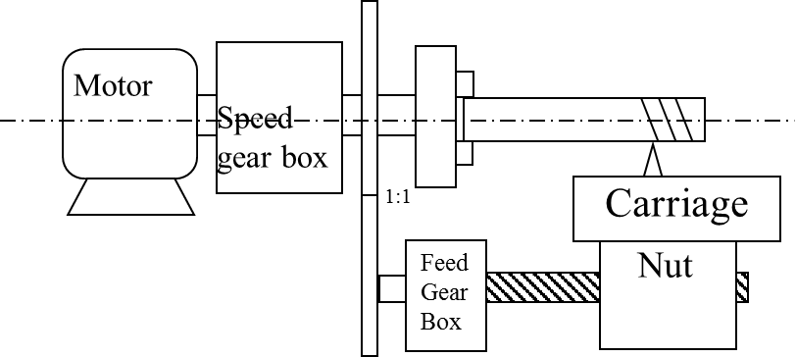
Is it possible to implement computer control on this machine tool ?

Slide 16
It will be possible if you add individual motors for each axis of motion, strip off the gear boxes, control the speed of the motors directly by controlling their applied voltage through computer controlled circuits.
Why ??
Gear boxes give discrete output rotational speeds, but you might want infinitely variable output from gear boxes. Infinitely variable drives are available without computer control, but not available in all conventional machines. In computer controlled machines, you can have infinite control of speed.
Why do we need infinitely variable drives in CNC machines?
To prevent speed loss, to achieve any taper that we want
Suppose you are turning in multiple passes: each pass will reduce the diameter and thenceforth, reduce the cutting speed (cutting speed = π.D.N/1000 m/min). In CNC machines, however, RPM is infinitesimally increased to compensate this loss in speed. So you throw out the gear box and go for computer control of motor speed.
Next – say you are moving a milling cutter on a conventional milling machine in automatic motion along an oblique path to cut a taper. You are combining auto motion along X axis and auto motion along Y axis to get the taper. How do you get these automatic motions? From the main motor, through gear boxes along X and Y axes. They provide very few discrete options. Better go for individual motors along X and Y axes controlled by computer to give you any angle of taper that you want.

Slide 17
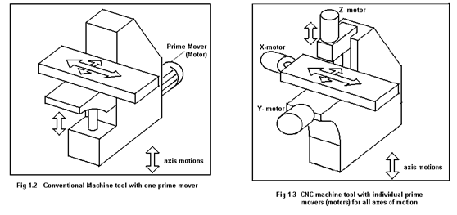
Simple kinematic chains for CNC machine tools

Slide 18
Advantages
Flexibility
It is possible to incorporate automation in low level production
Ability to cut complex profiles
Higher productivity and Accuracy in many applications
Initial investment is high
Required skill level of machinist, operator etc is high
Disadvantages

Slide 19
Practice MCQ questions
Main advantage of CNC machining over Fixed automation is
Flexibility b. Accuracy
c. Speed d. None of the others

Slide 20
The Spread of CNC technology
CNC machine tools find wide application in low level and medium level production.
CNC technology supports the realization of unconventional concepts in manufacturing – like Rapid Prototyping (RP)
It is possible to manufacture complex shapes by CNC

Slide 21
Types of Classification
Type of cutter movement (or motion control)
Point - to – point (P-T-P) and Continuous
Type of control - Open loop and Closed loop
Type of 'organization of machine operations' - Machine tool, machining centre and turning centre
Type and number of axis movements

Slide 22
PTP – Point-to-point control
The tool or cutter has to move from one point to another, the path of the cutter between these points is not critical
Examples
Drilling, EDM die sinking, spot welding, brazing, soldering
Salient features
The control system does NOT require an interpolator
The cutter moves from one point to another and carries out machining / required operation at these points.
It generally covers the distances between the points at highest attainable velocity.
Cutter radius compensation is generally not required

Slide 23
How do the PTP machines operate
There is (generally) no control of axial speeds. The axes may move at highest possible speeds
There is no cutting action while the tool is moving from one position to another.

Slide 24
Continuous control – straight cut
The cutter moves along straight lines at controlled rates between points
As the cutter moves, it removes material by cutting
Linear interpolation is carried out
Circular interpolation is not done

Slide 25

Continuous control with both linear and circular cuts
PART
Continuous control is required in CNC machine tools where a definite profile (2-D or 3-D) is being machined. In conventional automation, physical devices are used to force the cutter to carry out motion along the profile. In CNC, physical devices are absent. Part-specific tooling is not resorted to. Program execution makes the tool follow the required path.

Slide 26
Continuous control
The path and final destination of the tool or cutter needs to be controlled.
Examples : Lathe work, Milling
Point to note – the DPU (Data processing unit has a device called an interpolator)
The cutter velocity as well as the extent of motion (destination) are controlled.

Slide 27
Point-to-point control – one example
Pulse Generator
(1/200)x(1/4)x(8) = 0.01
Position down counter
1 | 1 | 0 | 1 | 0 | 1 | 1
AND
OR Gate
End of count
Lead screw 4 mm pitch, 2 start
CNC Table X →
Motor driver
Stepper Motor, 200 Steps/rev
Gear box Ratio = ¼

Slide 28
Explanations to the control loop elements
PDC = position down counter. It can be loaded with a binary number. A train of pulses input as shown will downcount the content of the counter, 1 bit for 1 pulse.
End of count = All the bits of the PDC are input to the OR gate. The OR gate will output a 0 only when all the inputs are 0. Which means – the contents of the PDC have been counted down to 0, so it is called ‘End of count’.
Pulse generator = The pulse generator sends out pulses continuously at a definite frequency

Slide 29
Explanations – cotd.
Gear Box – Normally, CNC machine tools do not employ gear boxes. However, they may be present as a fixed speed reducer for attaining a definite speed range. Gear ratio = Output RPM/Input RPM
Lead screw – nut mechanism : For 1 rotation of lead screw, the nut rotates by p × n = lead, where p = pitch and n = number of starts of screw
Stepper motor – is a motor which moves in discrete steps in response to voltage pulses as input

Slide 30
MCQ on P-T-P machines
The basic length unit (BLU) of the following drive is
5 microns b. 50 microns
c. 10 microns d. None of the others
p=4 mm pitch
Table
Stepper Motor, 200 Steps/rev
Gear box Ratio = ¼

Slide 31
When to use open loop
Open loop is employed when the prime mover can reliably move through the extent of motion programmed.
For example – the stepper motor can reliably move through discrete steps and stop exactly at a pre-defined location.
In the previous control loop shown – there is indeed a feedback loop – but it is internal

Slide 32
1. In a PTP open loop CNC drilling machine, a stepper motor drives the table in X direction. The stepper motor shaft is connected to a gear box with ratio (=output rpm/input rpm) ¼ which is in turn connected to a lead screw of pitch = 4 mm and no. of starts = 2. The stepper motor covers 1 rotation in 200 equal steps and executes 1 step per pulse of pulse generator (100 pulses per minute, ppm) received by motor driver. The pulses output from AND gate, go to motor driver and also to a position down counter (PDC). These incoming pulses decrement the content of PDC (1 pulse comes in, PDC content does down by 1). A. What are the BLU (basic length unit) and velocity of the table along x axis ? Line 1 G00 G90 X20 Y30 Line 2 X25 B. What number in binary will the MCU put into PDC for executing line 2 of program above ?
Position down counter
Pulse Generator, 100 ppm
AND Gate
1 | 1 | 0 | 1 | 0 | 1 | 1
OR Gate
End of count
Lead screw 4 mm pitch, 2 start
CNC Table X →
Motor driver
Stepper Motor, 200 Steps/rev
Gear box Ratio = ¼

Slide 33
Answer to problem
Ans :
BLU = 8 mm/800 = 0.01 mm = 10 microns
Velocity = BLU X PPM = 0.01 X 100 mm/min = 1 mm/min
Number to be put in binary inside PDC = 5/0.01 = 500

Slide 34
1. In a techno-fest for innovative designs – a student demonstrates a surface roughness tester he has developed. The stylus is moved with velocity V by a distance of 4 mm and it collects n number of profile data, one profile data for each step of the stepper motor. Stepper motor moves one step for each pulse and covers one rotation in 200 steps. The frequency of the pulses = f = 20 Hz. Pitch of lead screw = 1 mm.
(a) Find the value of n and V
(b) What is the distance covered by the stylus between two readings ?
V
Pulse freq, f
Nut,
p = 1 mm
Gear box ½
Stepper motor

Slide 35
distance between successive readings = BLU = 1 mm/400 =0.0025 mm = 2.5 microns
Number of readings in 4 mm sampling length = 4 mm/0.0025 = 1600
Velocity = BLU X PPS = 0.0025 X 20 = 0.05 mm/s = 3 mm/min

Slide 36
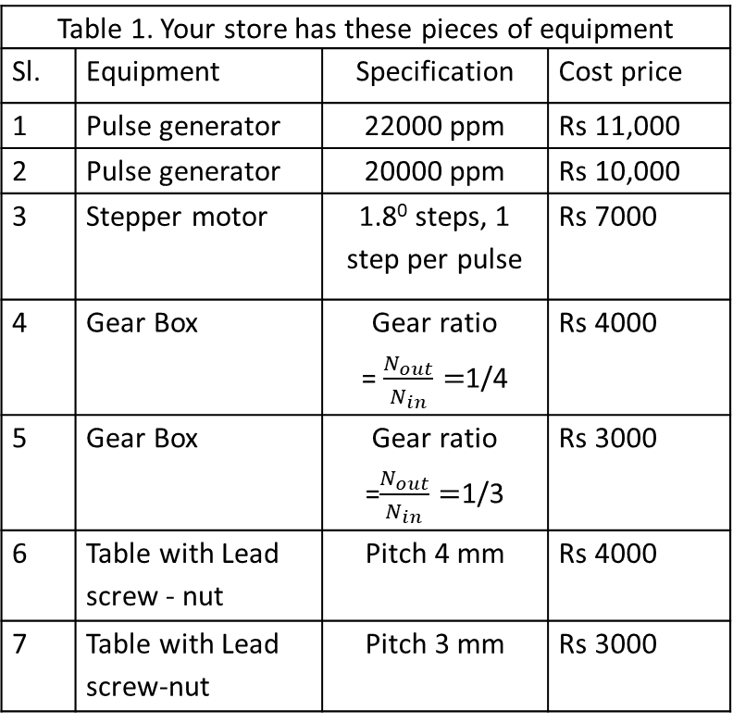
Numerical Problem 3.1
Table 1. Your store has these pieces of equipment
Sl. | Equipment | Specification | Cost price
1 | Pulse generator | 22000 ppm | Rs 11,000
2 | Pulse generator | 20000 ppm | Rs 10,000
3 | Stepper motor | 1.8⁰ steps, 1 step per pulse | Rs 7000
4 | Gear Box | Gear ratio = $\frac{N_{out}}{N_{in}}=$1/4 | Rs 4000
5 | Gear Box | Gear ratio =$\frac{N_{out}}{N_{in}}=$1/3 | Rs 3000
6 | Table with Lead screw - nut | Pitch 4 mm | Rs 4000
7 | Table with Lead screw-nut | Pitch 3 mm | Rs 3000
A company publishes a tender inviting quotations for a CNC PTP control table which moves only in one axis. The Basic length unit (BLU) is to be 5 microns and the axis velocity is to be 100 mm/min.
You represent another company which builds and sells machines by assembling different pieces of equipment (refer table 1).
Check whether you can build a machine to satisfy the above requirements [4] using 1 PG, stepper motor, 1 GB and 1 table.
Verify whether there is any chance that your quoted price (assuming you want to make a profit of only Rs 1000 for the CNC PTP control table) would be lowest, (refer table 2). [4]
 | Quoting company | Quoted price for CNC PTP control table
1 | Lakshmi Brs pvt ltd | Rs 26,500/-
2 | M/c builders Ltd | Rs 25,400/-
3. | CNC & Co. | Rs 24,300/-
4. | Nuts, Bolts & Comps | Rs 32,100/-
5. | Your company | ?

Slide 37
In a CNC machine with contouring control, the following commands are executed :
N01 G90 G00 X100 Y200 Z 20
N02 G01 X130 Y240 F50
What is the feed velocity of the cutter in the X direction in line N02 ?

Slide 38
Signals / variables which can take up only 2 values – Binary variables
Power supply
A = 0 volts
t, seconds
A = 5 volts
Power supply
t, seconds
A = Pulsed 5/0 volts
Power supply
t, seconds

Slide 39
Truth tables for some logic operations
A | B | A/ | B/ | A + B | A.B | A⊕ B | A#B
1 | 1 | 0 | 0 | 1 | 1 | 0 | 0
1 | 0 | 0 | 1 | 1 | 0 | 1 | 1
0 | 1 | 1 | 0 | 1 | 0 | 1 | 1
0 | 0 | 1 | 1 | 0 | 0 | 0 | 1

Slide 40
Binary logic operations
law of complements
a + a/ = 1
a . a/ = 0
a + 1 = 1
a . 0 = 0
a . 1 = a
a + 0 = a
Also
a+a = a
a.a = a
• Commutative law
a + b = b + a
a.b = b.a
• Distributive law
a.(b + c) = a.b + a.c
• associative law
a + b.c = (a + b) . (a + c)
• De Morgan’s laws
(a + b)/ = a/ . b/
(a . b)/ = a/ + b/

Slide 41
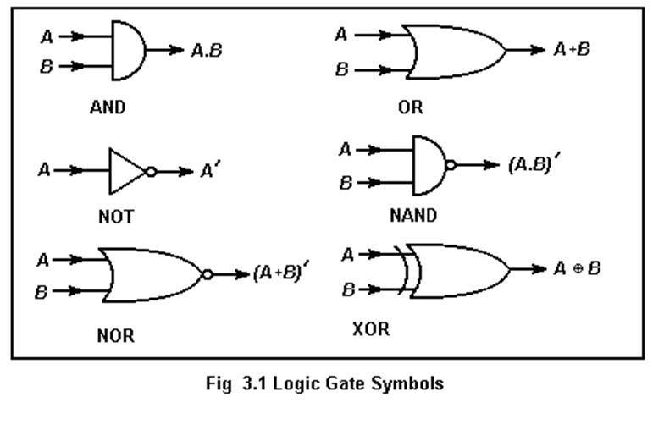
Symbols for logic gates

Slide 42
Addition of two bits
Decimal Binary
1 + 1 = 2 1 + 1 = 10
1 + 0 = 1 1 + 0 = 1
0 + 1 = 1 0 + 1 = 1
0 + 0 = 0 0 + 0 = 0
A | B | Carry | Sum
1 | 1 | 1 | 0
1 | 0 | 0 | 1
0 | 1 | 0 | 1
0 | 0 | 0 | 0
A | B | A/ | B/ | A + B | A.B | A⊕ B
1 | 1 | 0 | 0 | 1 | 1 | 0
1 | 0 | 0 | 1 | 1 | 0 | 1
0 | 1 | 1 | 0 | 1 | 0 | 1
0 | 0 | 1 | 1 | 0 | 0 | 0

Slide 43
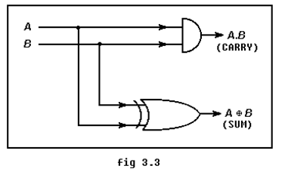
A half adder – can add up two bits
1010111
+ 0101110
01

